Slide 1
New Jersey Dynamic Learning Maps (DLM) Teacher Training 2023-2024
Division of Teaching and Learning Services
New Jersey Department of Education
Office of Assessments
January 2024

Slide 2
Preparation for the DLM Assessment
This presentation provides guidelines for:
  The use of documents and modules to prepare for the NJ DLM Year-End (YE) spring assessment; and
  The required training for teachers.
Your School or District Assessment Coordinator will answer any questions you may have about the assessment.

Slide 3
Table of Contents
Topic | Slides
DLM General Information | 4 to 15
NJ and DLM Required Teacher Training | 16 to 28
Preparation for Instruction and Assessment | 29 to 36
Professional Development and Educational Resources | 37 to 40
Educator Portal Surveys and Supports | 41 to 43
DLM Practice Testlets | 44 to 47
Test Administrators Manuals and Resources | 48 to 52
Reminders and Other Presentations | 53 to 55

Slide 4
NJ DLM General Information

Slide 5
Participation Criteria Guidelines
Students with the most significant intellectual disabilities are the only students eligible to take the New Jersey Dynamic Learning Maps (DLM) alternate assessment.
IEP teams must use the NJ DLM Participation Criteria Guidelines to make this determination.

Slide 6
Student Policies
Students in grades 3 through 8 and grade 11 participate in the English language arts and math assessments.
Students in grades 5, 8, and 11 also participate in the science assessment.
Retained students in grades 3 through 11 must participate in the DLM.
Current grade 12 students who did not participate in the spring 2023 administration of the DLM when in grade 11 are encouraged, but not required, to participate in the spring 2024 administration.

Slide 7
DLM Year-End (YE) Model and Test Window
New Jersey uses the DLM Year-End (YE) model which is a computer-based
assessment based on the NJSLS and DLM Essential Elements (EEs).
  The DLM IE testlets were made available to NJ educators in the fall of 2021 to assist with gathering benchmark data for DLM students in the absence of spring 2021 DLM data. Results from the DLM IE testlets are not predictive of student performance on the DLM YE spring assessment.
Test administration window is April 8 to May 31, 2024.
Districts should begin testing early enough to ensure completion during the testing window.
May 31, 2024 is the last day of testing, therefore students should consistently participate in the assessment by completing required testlets from April through mid-May.

Slide 8
YE Model Adaptive Assessment
The DLM assessment is a computer adaptive assessment. The computer adaptive process for the assessment includes:
  The teacher completes the student’s First Contact Survey indicating current level of demonstrated skill level, etc. These answers help the system pick the first set of test items.
  A student takes a small set of items, called a testlet, then the system considers the level of difficulty of the test items and the student’s performance (correct or incorrect answers).
  Based on the student’s performance another testlet is selected, which contain items that are around the same level, somewhat easier, or somewhat harder than the last testlet (same, lower, or higher-level skills are selected).
This is an iterative process until the testlets address all Essential Elements in the YE test blueprint.
The number of testlets varies based on grade and content area tested.

Slide 9
DLM Computer Based Testing
A small percentage of students will be assessed outside the system via DLM teacher administered tests. The student will not view the computer screen as the teachers will administer the questions based on their view of the testlets on the computer.
  When this occurs, a teacher will be asked to gather objects to use during the test.
  A student may sometimes have one teacher administered testlet, and the next testlet may not be teacher administered, depending on the adaptive nature of the test and modifications to the level of testlet assigned to the student.
Information on teacher administered testlets is found in the DLM Test Administration Manual.

Slide 10
Obtaining Test Specifications
Grade specific test specifications which delineate which DLM Essential Elements and skill statements are tested in the YE model should be reviewed.
Use the links to the Educator Resource pages for information on:
  Test specifications for ELA and math
  Test specifications for science

Slide 11
Test Administrator Responsibilities
Test administrators:
  Are classroom teachers
  Administer assessments to students and assist in the selection of accessibility features and necessary supports
  Complete First Contact surveys and Personal Needs and Preferences (PNP) Profiles
  Verify correct students are on assigned rosters
  Administer practice tests
  Review Test Administration Manual
  Review Accessibility Manual
Contact your School Assessment Coordinator if you have questions.

Slide 12
DLM Educator Roles
Teachers may not fulfill the other DLM designated roles:
  District/School Assessment Coordinators
  District Data Manager
Teachers will receive their DLM login ID and password after their District Data Manager uploads the teacher’s information into the DLM Educator Portal.

Slide 13
Additional District-Level Roles and Responsibilities
There are three additional roles for district-level staff in the DLM testing process.
  The School and District Assessment Coordinators:
    Are the point of contact for all assessment responsibilities excluding the tasks of the two roles listed below.
    Oversee and assist teachers in their roles.
    Schedule teacher training and ensure proper test administration.
  The Technology Representative will load the DLM Kite application onto computer devices in order to allow for access to the practice tests and to administer spring testing.
  The Data Manager will upload and review data to create the classroom test rosters, obtain all login IDs for the district, and add new students to the system as necessary.

Slide 14
Test Administrator Tasks
Complete District teacher training (NJDOE PowerPoint modules and DLM training site modules) and implement instruction related to New Jersey Student Learning Standards (NJSLS) and DLM Essential Elements (EEs).
Review DLM materials including test blueprints, manuals etc., and review professional development modules as needed.
Complete First Contact (FC) and Personal Needs and Preferences (PNP) Profiles once rosters are completed by March 18, 2024.
Attend District training on preparation for NJ DLM, administer practice tests, create testing schedule & produce student testing folders in March 2024.
Conduct NJ DLM testing April 8 to May 31, 2024.
  Note: Districts should begin testing early enough to ensure completion during the testing window.

Slide 15
Steps for Teachers Administering the DLM
Timeline | Action Steps
September – January | Implement instruction related to New Jersey Student Learning Standards (NJSLS) and DLM EEs Review DLM materials including, test blueprints, EEs, etc.; and Review professional development modules as needed Complete teacher training (PowerPoint and DLM training site modules)
February – March | Complete First Contact (FC) and Personal Needs and Preferences (PNP) Profiles once rosters are completed Review training materials including DLM Accessibility Manual Complete training on Preparation for NJ DLM Administer practice tests Create testing schedule Produce student testing folders
April 8 through May 31 | Administer the DLM assessment to students Note: Districts should begin testing early enough to ensure completion during the testing window.

Slide 16
Required Teacher Training:
PowerPoint and DLM Training Site

Slide 17
DLM Training Site Modules
The DLM training site is used to provide the mandatory teacher training modules required by NJDOE.
District or School Assessment Coordinators will conduct and oversee the training of teachers using both the DLM training site and the NJ teacher training materials.
Note: Test administrators who passed all the required training in the fall do not need to repeat the test administrator training for the spring 2024 administration. ​

Slide 18
Returning Test Administrator for 2023-2024
In most cases, Returning Test Administrators tested students with the DLM last year.
Someone is designated a Returning Test Administrator if, in the 2022-23 school year, they:
  Passed all DLM modules; and
  Received a certificate in their current district.
Someone is still considered a Returning Test Administrator if they:
  Were designated as a back-up Test Administrator; and
  Passed the modules/received certificates (even if they did not administer the DLM last year).
Note: Test administrators who passed all the required training in the fall do not need to repeat the test administrator training for the spring 2024 administration.

Slide 19
New Test Administrator for 2023-2024
Someone is designated a New Test Administrator if, in the 2022-23 school year they did not take and pass the DLM modules.
Test administrators are only considered "returning" if they have no gaps in taking and passing the annual test administrator training.
  Therefore, if test administrators did not take the test administrator training for the 22-23 administration because the DLM was not administered in the district, they are designated "New" test administrators for 23-24 and must take and pass the "New" test administrator training.
Note: Test administrators who passed all the required training in the fall do not need to repeat the test administrator training for the spring 2024 administration.

Slide 20
Administered DLM Last Year and Changed School Districts
The DLM training site accounts are associated with teachers’ email addresses.
If you are listed as a New Test Administrator on the DLM training site because you are working in a different district than you were last year and/or your email address has changed, even though in 2022-2023 you passed the module post-tests and received certificates, this can be revised.
  Present the test administrator training certificates to your Assessment Coordinator and ask that they email assessment@doe.nj.gov and DLM Support to request that your status be changed in the system to a Returning Test Administrator.

Slide 21
Required Reading
Download DLM’s Guide to DLM Required Test Administrator Training for important information on:
logging into the DLM
resetting passwords
post-tests
facilitated versus self-directed training, etc.

Slide 22
DLM Required Training for Returning Test Administrators
The DLM required training is one module titled, Returning Test Administrator Training – Review of the DLM Alternate Assessment System. This module is approximately 45 minutes.
After viewing the module, the teacher must independently complete a four-part post-test.
  If you score below 80% accurate, the DLM system will provide and require additional training and post-tests.
  You may review the module and take the post-tests as many times as necessary in order to achieve 80% or higher.

Slide 23
DLM Required Training for New Test Administrators (1 of 2)
The DLM required training is four modules.
Part 1 – About the DLM System
Part 2 – Understanding and Delivering Testlets
Part 3 – Test Administration and Scoring
Part 4 – Preparing to Administer the Assessment
These modules are approximately 2.5 hours.

Slide 24
DLM Required Training for New Test Administrators (2 of 2)
After viewing each module, the teacher must independently complete a post-test.
  If you score below 80% accurate on any post-test, you must review the training materials again and retake the post-test(s).
  You may take the tests as many times as necessary in order to achieve 80% or higher.
There is also an optional module entitled Personal Learning Profile Training, which provides more information about completing a student’s Personal Needs and Preferences (PNP) Profile and First Contact survey.
  There is no post-test for this module.
  This module is also available on DLM’s website to view at any time.

Slide 25
Assessment Coordinator Schedules Training (1 of 3)
Assessment Coordinators may train all Test Administrators as one group (Returning and New Test Administrators) using all five modules.
After the training, each Test Administrator must:
  Independently and separately login into the DLM training site;
  Click on “Facilitated Training” (this tells the system you don’t need to view the modules because someone showed them to you); and
  Take assigned post-test(s)
    One post-test if a returning test administrator
    Four post-tests if a new test administrator

Slide 26
Assessment Coordinator Schedules Training (2 of 3)
Assessment Coordinators may choose to split the group into a “Returning Test Administrators” group and a “New Test Administrators” group for training.
After the training, each test administrator must:
  Independently and separately login into the DLM training site;
  Select “Facilitated Training” (this tells the system you don’t need to view the modules because someone showed them to you); and
  Take assigned post-test(s).

Slide 27
Assessment Coordinator Schedules Training (3 of 3)
Be advised that even when trained in a facilitated setting alongside new test administrators, there is no facilitated option in the DLM Training site for returning test administrators, only self-directed.
Upon logging into the DLM training site, returning test administrators will need to play the self-directed returning training video then proceed to the post-tests.
The returning video includes the highlights of the four modules for new test administrators.

Slide 28
Individual Teacher Training
The Assessment Coordinator may also choose to assign a time during school hours for Test Administrators to separately view the module(s) and take the post-test(s).
To independently complete the modules and post-tests:
  Login into the DLM training site;
  Select “Self-Directed Training”;
  View the module(s); and
  Take assigned post-test(s).

Slide 29
How To Access the Required DLM Training
See the Guide to DLM Required Test Administrator Training 2023-2024 for information on use of login ID, password updates, DLM training site access, etc.
The district Data Manager will provide login ID to Test Administrators if they do not already have one.

Slide 30
Preparation for Instruction and Assessment

Slide 31
Instructional Program Preparation
Teachers and school program staff must review the Essential Elements (EEs) and implement individualized instruction related to the EEs.
The Essential Elements are skill statements written to align with the NJSLS at an appropriate linkage level for students with significant cognitive disabilities. EEs and nodes (specific skills) are important to review and address during instruction.
Note that ELA and math have five linkage levels, while science currently has only three linkage levels.
  More details are presented in upcoming slides.

Slide 32
Use of the Test Information
Use of the Essential Elements, linkage levels, and nodes (skill statements related to the map), and the YE test blueprint will guide instruction, assist in selecting individualized targeted skills related to the NJSLS, and help prepare students for the DLM assessment.
School program staff and district curriculum specialists should assist in the development of instructional plans based on the DLM Year-End (YE) test blueprints.
DLM also provides Professional Development (PD) modules that are designed to teach conceptual areas related to NJSLS and the DLM EEs.

Slide 33
  What do teachers/test administrators need to do this school year to prepare for the DLM? (1 of 2)
Review the training materials designed to prepare you for instruction aligned to the Essential Elements (EEs) and administration of the DLM.
Prepare your students by providing instruction linked to the NJSLS and the related DLM EEs.
  Develop instructional lessons related to the EEs.
    EEs are comprised of linkage levels and nodes that show how skills are related and build on one another.
    Linkage levels and nodes help teachers understand how to route instruction for the diverse population of participating students.
  Incorporate computer use, manipulatives, familiar texts, writing tasks, and DLM skills into your instruction.
Complete required DLM training.

Slide 34
  What do teachers/test administrators need to do this school year to prepare for the DLM? (2 of 2)
View 2–3 minute Instructional and Informational videos on the Educator Resource Videos page in preparation for assessment.
Complete in the First Contact and Personal Needs and Preferences (PNP) Profiles for each student on your rosters in February 2024.
    It may be helpful to begin these surveys on paper so that you can consider the responses.
Prepare students for the DLM through practice tests.
Check NJ DLM webpage for training material updates.

Slide 35
How to Find the Linkage Levels (1 of 2)
Another way to view the EEs is the “Currently Tested” webpages by content area:
  Mathematics
  ELA
  Science
Each EE is a clickable link that reveals the linkage levels and nodes for the EE.
This resource is particularly helpful in determining routes of learning for individual students.
Essential Elements with a gray flag icon beside them are not assessed in the YE model but can still be useful in instruction.

Slide 36
How to Find the Linkage Levels (2 of 2)
Example of Grade 3 from the Currently Tested Essential Elements for ELA
Note: Essential elements marked with a gray flag (⚑ )are not assessed in Year End states.
Grade 3: Essential Elements Assessed
EE.RL.3.1 Answer who and what questions to demonstrate understanding of details in a text.
⚑EE.RL.3.2 Associate details with events in stories from diverse cultures. (gray flag indicating not assessed in Year End states)
EE.RL.3.3 Identify the feelings of characters in a story.
⚑ EE.RL.3.5 Determine the beginning, middle, and end of a familiar story with a logical order. (gray flag indicating not assessed in Year End states)
⚑ EE.RI.3.1 Answer who and what questions to demonstrate understanding of details in a text. gray flag indicating not assessed in Year End states)
EE.RI.3.2 Identify details in a text.
EE.RI.3.3 Order two evens from a text as “first” and “next”.
⚑ EE.R.3.5 With guidance and support, use text features including headings and key words to locate information in a text. gray flag indicating not assessed in Year End states)

Slide 37
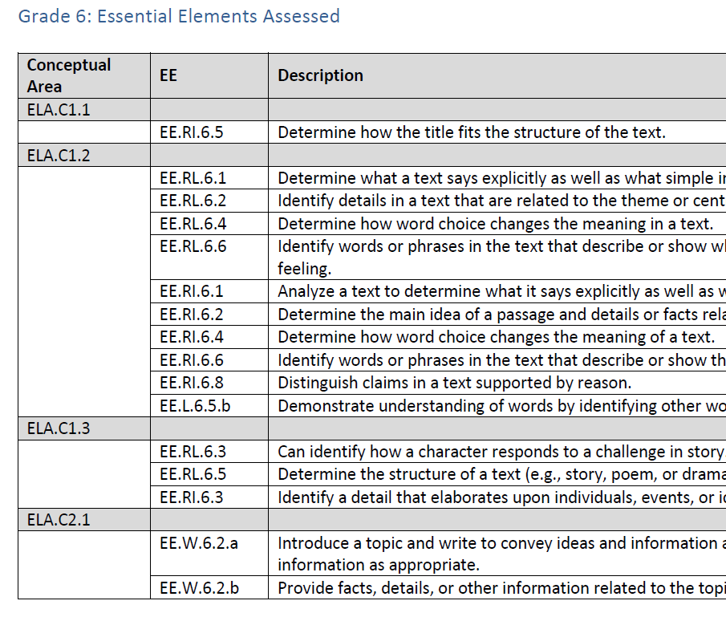
Test Blueprint
A test blueprint pdf is available for each subject.
Blueprints list the EEs assessed at each grade.
The test blueprints can be found on NJ’s page of the DLM website:
  Under the “Instructional Resources” filter.
Example of the Grade 6 blueprint for ELA

Slide 38
Instructional and Informational Videos
Instructional and Informational videos can be obtained through the Educator Resource Videos page for topics including:
  Accessing and maneuvering through Education Portal
  Testlet Overviews
These videos are most beneficial when viewed in conjunction with the training modules.

Slide 39
Professional Development and Educational Resources

Slide 40
Professional Development
DLM Professional development modules developed by the University of North Carolina (UNC) support the design and delivery of this instruction.
These modules are different from the required DLM training modules, but are highly recommended and optional.
The PD modules on topics related to math, writing, reading, and science instruction provide information that is useful for classrooms and school programs.
Topics are broad and include information about alternate pencils (writing topic), algebraic thinking, predictable chart writing, place value, etc.
Viewing the PD modules is encouraged and topic selection is based on a teacher’s interest in specific areas.
Modules can be sorted according to DLM Claim or in alphabetical order.

Slide 41
Obtaining PD Checklist
Professional development modules are sorted by the alphabetized list or claims list. A check list is available to download so you may track which modules you have viewed.
Access the website for the DLM Professional development modules.

Slide 42
Recap of Materials
Using the following DLM resources will help to instruct your students and prepare them for assessment:
DLM Professional development modules
Essential Elements which note the grade level and target skills
Test Blueprints for list of tested skills

Slide 43
Educator Portal Surveys and Supports

Slide 44
Online Surveys
During February 1 through March 18, 2024, you will need
to complete the First Contact (FC) survey and the Personal Needs and Preferences (PNP) Profile for each student on each of your subject test rosters.
Please review the DLM Accessibility and Test Administration manuals in order to consider which survey responses and accessibility features to use for each student.
More information on the FC survey and PNP Profiles are found in the Educator Portal User Guide.

Slide 45
Accessibility Supports
DLM offers a variety of accessibility supports during assessment.
Some supports are delivered through the Kite Student Portal and are determined by responses to the First Contact (FC) and Personal Needs and Preferences (PNP) Profile.
  Category 1 supports delivered via Kite include magnification, inverted color choice, color contrast, overlay color, and computer spoken audio.
  Category 2 supports require additional tools and/or materials. These include Single-switch System/PNP Profile Enabled, Two-switch System, individualized manipulatives, etc.
  Category 3 supports provided outside the system include Test Administrator read aloud, sign interpretation of text, language translation of text, etc.
  Pages 21–24 of the Accessibility Manual provide additional details explaining the support categories.

Slide 46
DLM Practice Testlets

Slide 47
Practice Testlets
Practice testlets are available in DLM Kite Student Portal and should be administered to students prior to March 2024.
Practice testlets relate to some accessibility features the student may use. Select the practice testlets (“demos”) based on the PNP features.
The purpose of using the practice items is to give the student experience with the online test experience prior to answering live test questions.
  This allows the student and teacher to be aware of the computer features, and helps to determine whether the student or teacher would “drive” (use the computer mouse) during testing.

Slide 48
Practice Testlet Access
Refer to the Test Administration manual along with pages 1 and 2 of the Guide to Practice Activities & Released Testlets Year-End model for information on accessing practice testlets.
Personalized practice testlets are not available in the DLM system. The practice test button seen on screen after logging in to a student’s account does not function.
Practice testlets login ID always start with “demo” for the login info.
Do not use the student’s login ID and password when looking for practice tests.

Slide 49
Engagement Activities
DLM engagement activities are included in each testlet.
The engagement activities are meant to give the student a context for the questions, taps and activates prior knowledge and experience, and/or introduces the concept(s) to be addressed.
The engagement activities do not require a student response to a DLM test question.
The test administrator will engage the student in the activity and may ask factual questions without leading the student to answers.

Slide 50
Test Administrators Manuals and Resources

Slide 51
DLM Materials for Review
The NJ DLM webpage currently contains updated manuals and information as well as some files that are not yet updated.
As DLM or NJ revises the documents you will see a note to the right of the title with the date of the update.
Please make sure you access only current materials, and if necessary, wait to download some documents until you see the new version indication.

Slide 52
Kite Suite
“Kite Student Portal is for Kids”
Access student operational testlets
Practice testlets (e.g., demo.lisa)
Utilize student usernames and passwords
“Kite Educator Portal is for Educators”
Utilize teacher username and password
Access student rosters
FC and PNP surveys
TIPs page
Retrieval of student usernames and passwords

Slide 53
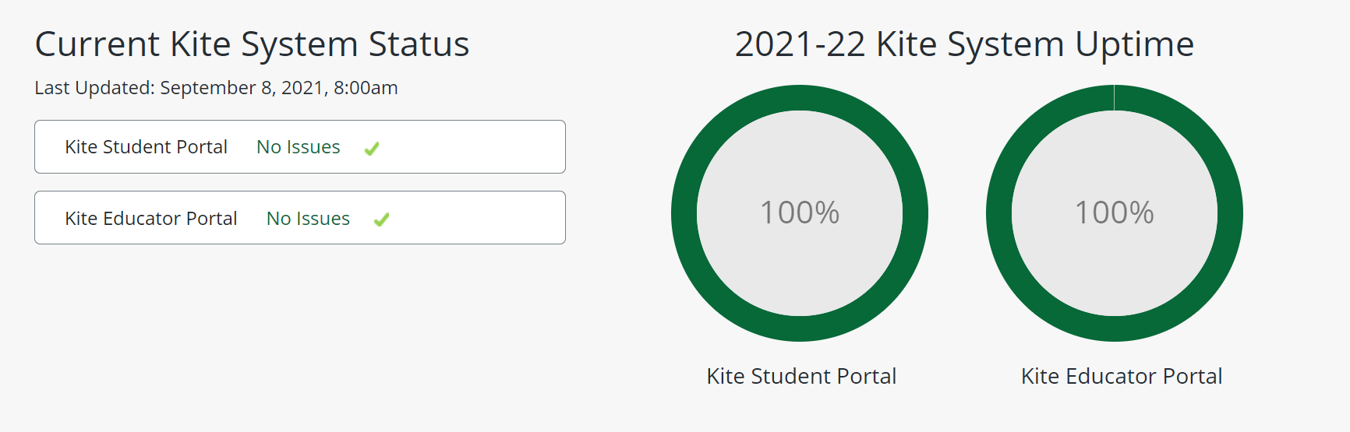
Kite and Educator Portal Status Check
The status code indicates if Kite and Educator Portal system is operating normally. Check each status before logging in to either system. A code of yellow or red will indicate a problem.
Please wait until the system shows the green “No Issue” status before using it.

Slide 54
How to Navigate Educator Portal
For a step by step video instruction, go to Educator Resource Videos page, then click on video links as needed to get information about:
Getting Started in Educator Portal
Using Student Portal with Alternate Assessments
Test Tickets and TIPs

Slide 55
DLM Reminders
Educators must regularly check the NJ DLM webpage for material updates as the information is continuously updated.
  Teachers should subscribe to the automatic test updates on the DLM homepage.
  This website contains all training materials, web links, and important information regarding district preparation and implementation of the DLM that are updated frequently.
  The revision date is listed to the right of the document name.
NJ presentations call attention to the mandatory DLM documents educators must review; NJ presentations do not deliver all details needed for DLM.
Review all referenced documents.

Slide 56
Presentation Information (1 of 2)
NJ DLM Preparation Parts 1 and 2 presentations must be viewed by Assessment Coordinators and teachers administering the test.
Teachers must adhere to all NJ test policies outlined in the presentations and must sign the New Jersey DLM Test Security Agreement.

Slide 57
Presentation Information (2 of 2)
Preparation Parts 1 and 2 Presentation Topics include:
Scheduling Students
Creating Student Test Folders
Test Security and Confidentiality
Substitutions for Manipulatives
Clarifying Test Directions
Use of Test Information Pages (TIPs)
Number of Required Testlets per Grade & Subject
Checklist for Teachers’ Testing Tasks

Slide 58
Follow Us on Social Media
Facebook: @njdeptofed
Instagram: @newjerseydoe
LinkedIn:
New Jersey Department of Education
Threads:
@NewJerseyDOE
X: @NewJerseyDOE
YouTube: @newjerseydepartmentofeduca6565

Slide 59
Thank You!
New Jersey Department of Education: nj.gov/education
The Office of Assessment: assessment@doe.nj.gov

